Slide 1

Personalized Product Recommendations for Enhanced Retailer Experience
Revolutionizing B2B Retail with AI-Powered Insights
Hackathon: ByteXL Hackathon 2025
Team: High5 Coders ✋
College: QIS College of Engineering & Technology
Roles: Leader | AI Engineer | Developer | Designer | Presenter

Slide 2
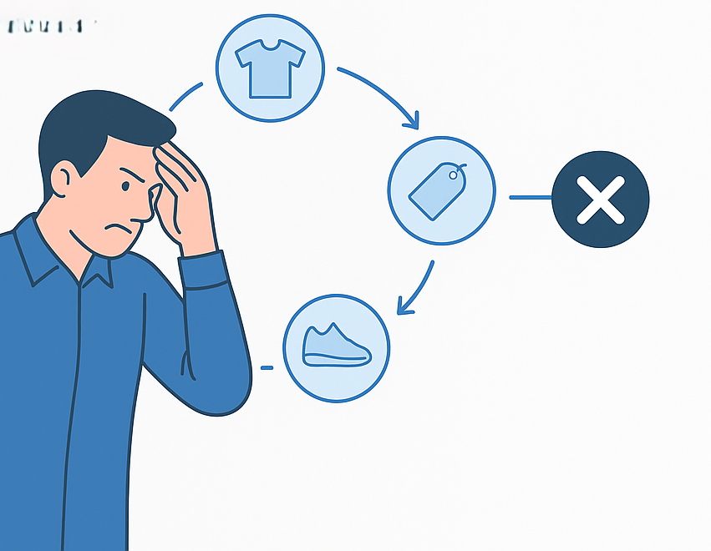
The Challenge for Retailers
• Retailers face repetitive buying patterns → missed opportunities.
Difficulty in discovering relevant products efficiently.
Leads to suboptimal sales and business growth for both retailers and distributors.

Slide 3
Impact on the B2B Marketplace
Stagnant retailer experience = lost revenue.
Missed product discovery = missed partnerships.
No personalized guidance = inefficient purchasing.

Slide 4
AI-Powered Personalized Recommendations
Intelligent product suggestions based on retailer behavior.
Predictive analytics for optimal purchasing.
Real-time updates with trend-aware recommendations.

Slide 5
Technology That Powers the Solution
Web Development: Node.js + Express/Fastify, Python Flask/FastAPI, Microservices, PostgreSQL/MongoDB
AI/ML: scikit-learn, TensorFlow/PyTorch
API & Integration: REST/GraphQL, WebSockets, OpenAI/Gemini

Slide 6

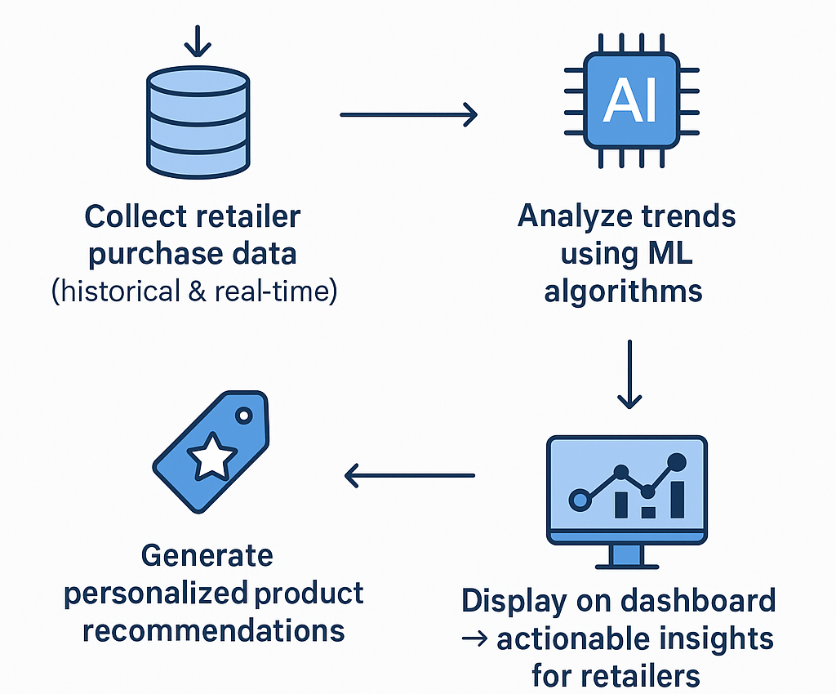
Behind the Scenes
1. Collect retailer purchase data (historical & real-time).
2. Analyze trends using ML algorithms.
3. Generate personalized product recommendations.
4. Display on dashboard → actionable insights for retailers.

Slide 7
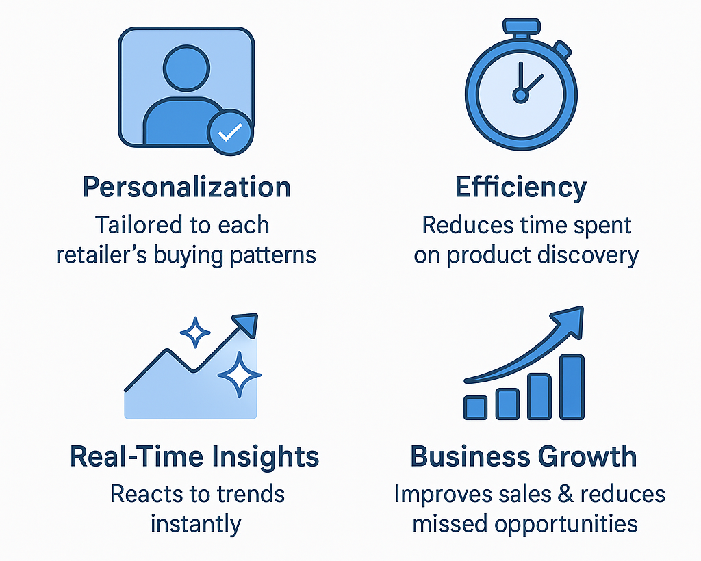
What Makes Our Solution Stand Out
Personalization: Tailored to each retailer’s buying patterns.
Efficiency: Reduces time spent on product discovery.
Real-Time Insights: Reacts to trends instantly.
Business Growth: Improves sales & reduces missed opportunities.

Slide 8

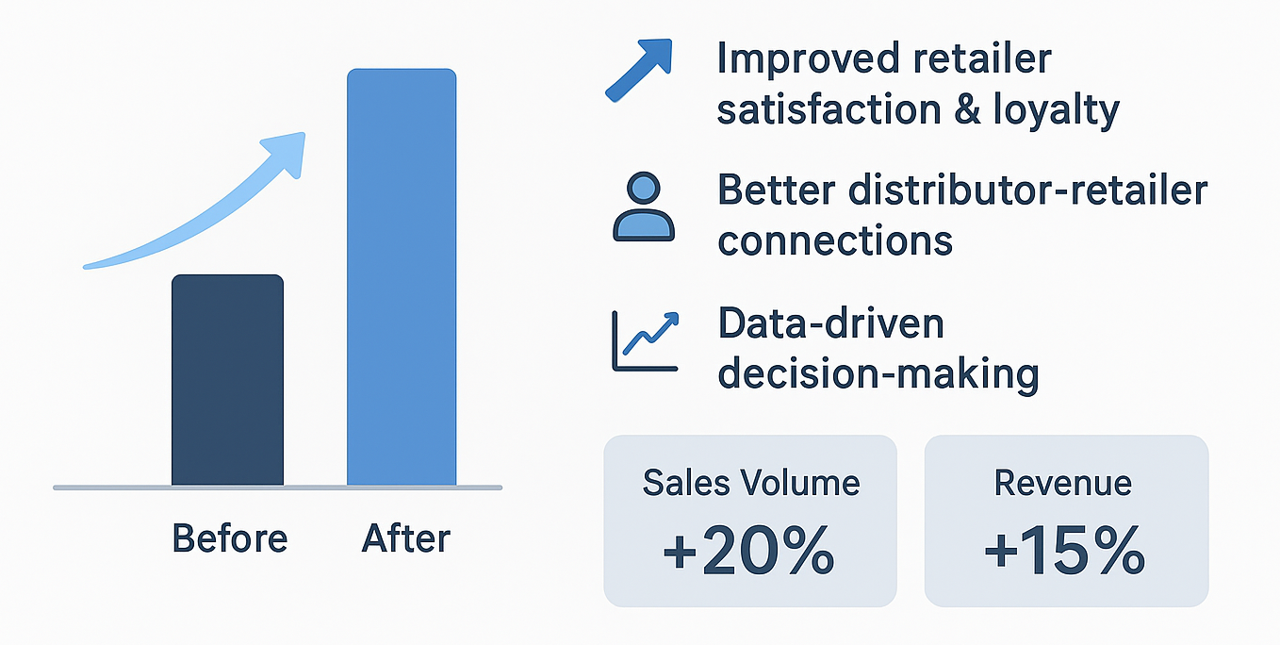
Business & Retailer Benefits
Increased sales volume & revenue
Improved retailer satisfaction & loyalty
Better distributor-retailer connections
Data-driven decision-making

Slide 9
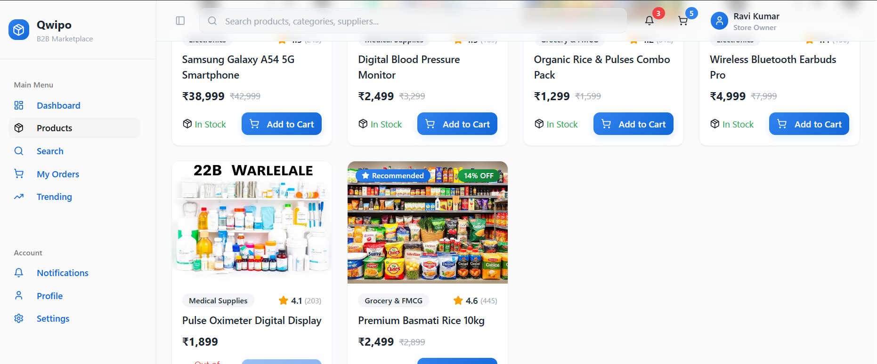
Sneak Peek
Show Figma/Prototype screenshots of the web app.
Highlight product cards, recommendation bubbles, and filters.

Slide 10
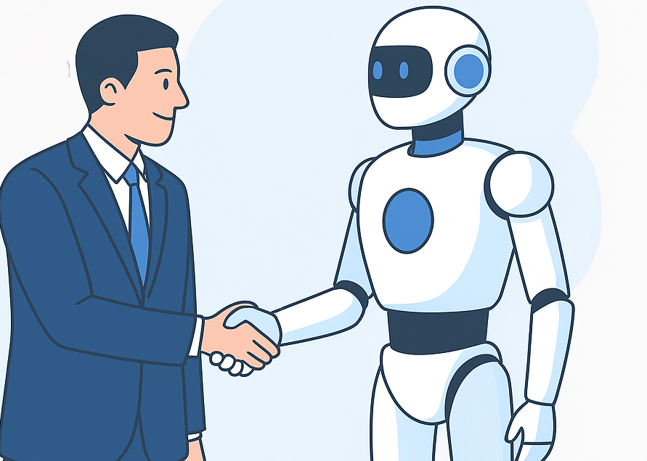
The Future of B2B Retail on Qwipo
Personalized recommendations = smarter, faster, and more profitable shopping.
AI transforms repetitive buying into opportunity-driven growth.
Ready to enhance the retailer experience on Qwipo!

Slide 11
Team & Acknowledgements
Team: high5coders
Leader: D.Sai Sree Vaishnavi
AI Engineer: Ch.Vyshnavi
Developer: N.Dharani
Designer: A.S AdityaRam
Presenter: D.Sai Sreekar
Special thanks to hackathon organizers & mentors.

Slide 12
THANK YOU

